Slide 1

RGB-D Tracking
By Wenzhang Qian
April 3, 2018

Slide 2
RGB-D Camera
An RGB-D camera combines best of the active and passive sensor worlds, in that it consists of a passive RGB camera along with an active depth sensor. An RGB-D camera, unlike a conventional camera, provides per-pixel depth information in addition to an RGB image.
Traditionally, the active depth sensor is an infrared (IR) projector and receiver. Much like a Continuous Wave Time of Flight sensor, an RGB-D camera calculates depth by emitting a light signal on the scene and analyzing the reflected light, but the incident wave modulation is performed spatially instead of temporally.

Slide 3
Here we can see an example of a standard RGB-D Camera:

Slide 4
This is done by projecting light out of the IR transmitter in a predefined pattern and calculating the depth by interpreting the deformation in that pattern caused by the surface of target objects. These patterns range from simple stripes to unique and convoluted speckle patterns.

Slide 5
Graph

Slide 6
Point Cloud
Point clouds are digital representations of three dimensional objects. In practical implementations, they can also contain additional metadata for each point, as well as a number of useful methods for operating on the point cloud.

Slide 8
Advantage from depth
When the target rotates, deforms or is under occlusion.
Target appearance can change significantly after rotation or deformation, making recognition difficult, which are the main causes of model drifting for traditional RGB tracker.
The depth or 3D features are still distinguishable when the similarity in RGB vanishes.
[Song, S., Xiao, J. Tracking Revisited using RGBD Camera: Baseline and Benchmark(2012). https://arxiv.org/abs/1212.2823]

Slide 9
Detection based tracking
RGBD HOG Feature
Point Cloud Feature

Slide 10
RGBD HOG Feature
RGBD HOG feature is the histogram of oriented gradients computed from both RGB and depth images. HOG for depth is obtained by treating depth data as a grayscale image. This RGBD HOG feature describes local color textures as well as 3D shapes, improving robust- ness against target illumination variation, lack of texture and similarity in color to the background.

Slide 11
Point Cloud Feature
Point cloud feature is designed to capture the color and shape of cells of 3D points. We first divide 3D space into cubic cells, then for each cell we compute three features: (1) a color histogram in color names space, (2) the number of points in the cell and (3) 3D shape feature. Color name is a linguistic label assigned to color spectrum space. The color name feature is computed by first mapping the RGB value of each point to one of the 11 basic color names and then building a histogram of these color names within each cell. The 3D shape feature is composed of scatter-ness, linear-ness and surface- ness of the point distribution inside each cell, obtained from its principal components

Slide 12
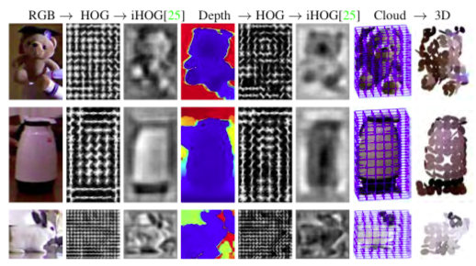
Visualization of features

Slide 13
Point Tracking
2D optical flow tracking
3D iterative closest point tracking

Slide 14
2D optical flow tracking
The 2D optical flow tracker adopts large displacement optical flow on RGB data from consecutive frames, then generates the bounding box of points validated by forward-backward checking.

Slide 15
3D iterative closest point tracking
For 3D tracking, we adopt Iterative Closest Point (ICP) algorithm, which iteratively computes a rigid transformation that minimize the sum of mean square error between two set of points in real time. The rigidity assumption holds in most cases, but it might fail when the target deforms and produces a large error E(R, t, s). In this case, according to the small motion assumption, our tracker looks for the target near its previous position. We treat the biggest connected component in the neighborhood of the previous position as the new target position, and return a 3D bounding box that encompasses it.

Slide 16
Kernelized Correlation Filter (KCF)
The current plan is to integrate point cloud into the RGB KCF tracker.
The KCF tracker combines high accuracy and fast processing speed.
It is in the eighth position in the top ten rank in [Wu, Y., Lim, J., Yang, M.: Online object tracking: a benchmark. In: IEEE CVPR, pp. 2411–2418 (2013)] while being the fastest.
Personally, that is my favorite tracker in OpenCV.

Slide 17
DS-KCF
[Hannuna, S., Camplani, M., Hall, J. et al. J Real-Time Image Proc (2016). https://doi.org/10.1007/s11554-016-0654-3] proposed an augmented version of KCF with point cloud called DS-KCF.
It improves on the performance of the KCF tracker by
integrating depth and colour features in the KCF framework, and efficiently handling
scale changes
occlusions
aspect ratio changes of the target model

Slide 18
Processing pipeline in the KCF tracker
The pipeline is comprised of training, detection, retraining. The final step includes updating the previous frame’s model parameters with the current one based on an empirically determined interpolation factor.

Slide 19
Math behind it
A lot of math here
But I will leave them to myself

Slide 20
Pipeline of DS-KCF tracker
We integrate an efficient combination of colour and depth features in the KCF tracking scheme. We provide a change of scale module, based on depth distribution analysis, that allows to efficiently modify the tracker’s model in the Fourier domain. Different from other works that deal with change of scale within the KCF framework, such as, our approach estimates the change of scale with minimal impact on real-time performance. We also introduce an occlusion handling module that is able to identify sudden changes in the target region’s depth histogram and to recover lost tracks. Finally, a change of shape module, based on the temporal evolution of the segmented target’s silhouette, is integrated into the framework. To improve the tracking performance during occlusions, we have added a simple Kalman filter motion model.

Slide 22
Accuracy

Slide 23
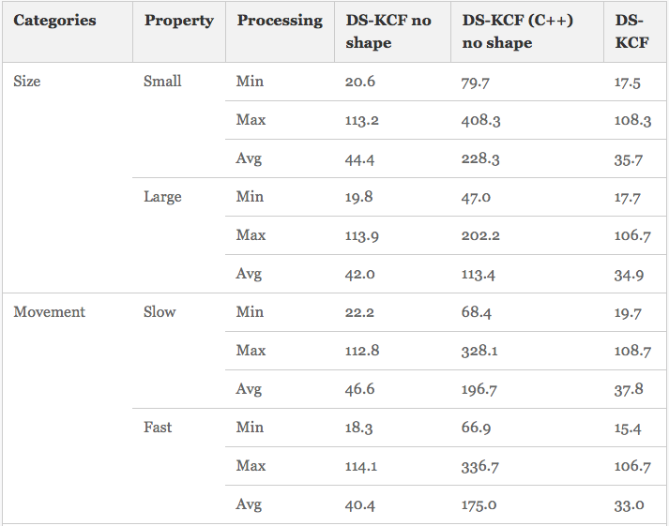
Processing rate

Slide 24
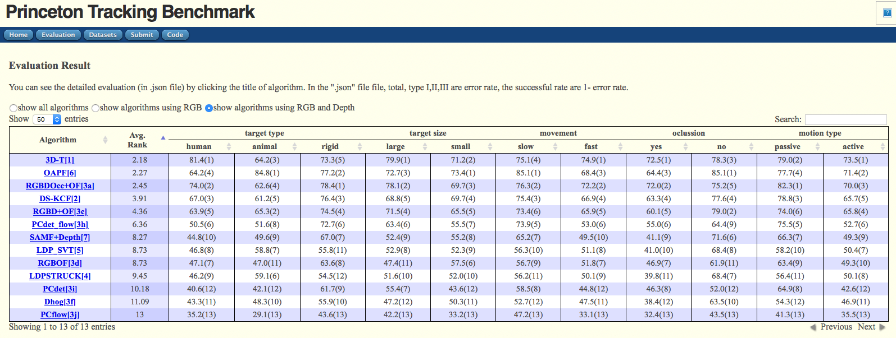
Princeton Tracking Benchmark
http://tracking.cs.princeton.edu

Slide 25
My plan

